Slide 1
Regional Response to Climate Change – Climate Financing by the Multilateral Development Banks
Climatters 2018
From Person to Planet: Scaling Sustainable Practices
MÁRIA BÁBOSIK
Economist, Central Bank of Hungary
PhD student, University of Pécs
Budapest, May 24, 2018

Slide 2
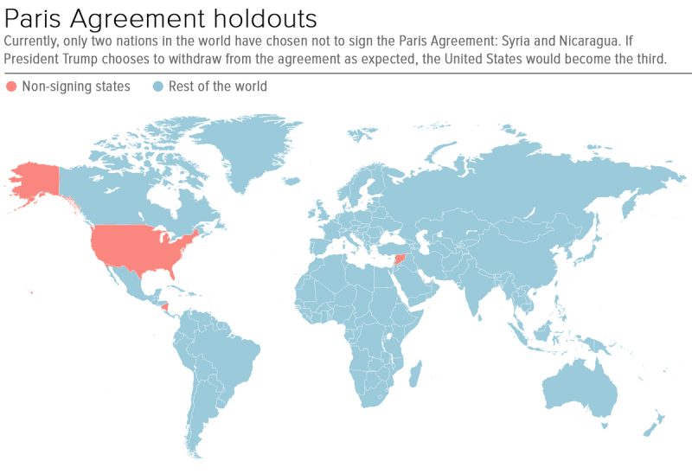
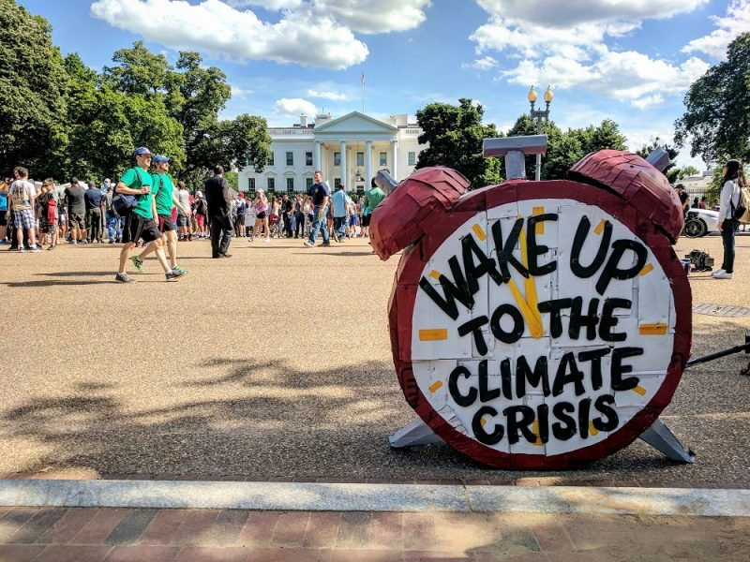
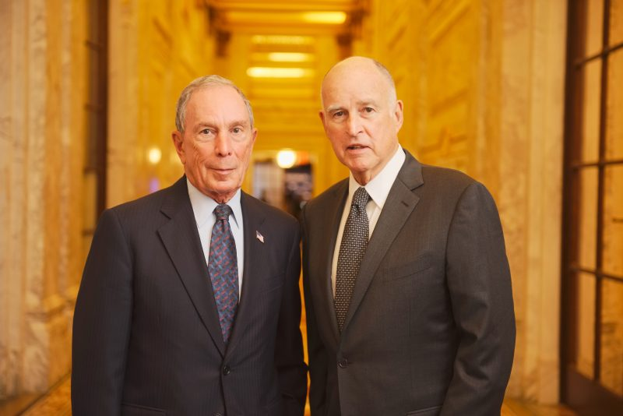
Relevance of the topic
June 1, 2017:
USA withdrawn from the Paris Agreement
America’s Pledge:
cities, states & businesses
(<50% of U.S. economy & population):
“We Are Still In”
November 9, 2017:
Syria:
announced to sign the Paris Agreement
EU :
Provisional Agreement
to put the EU on track
to achieve its commitment
under the Paris Agreement
Mária Bábosik

Slide 3
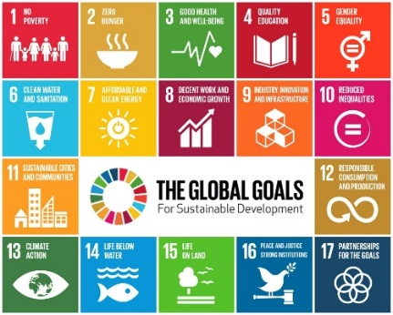
From climate change to climate finance
Climate change
Climate protection
Climate finance
Mária Bábosik

Slide 4
Climate finance defined
All financial sources related to mitigation and adaptation due to climate change
(aid, private sources, equity investments
related to climate protection)
Broader terms
Narrower terms
Public financial sources
provided by developed countries to developing countries
for mitigation and adaptation to climate change
(bilateral, multilateral)
part of
environment finance
partly overlaps with
green finance
Mária Bábosik

Slide 5
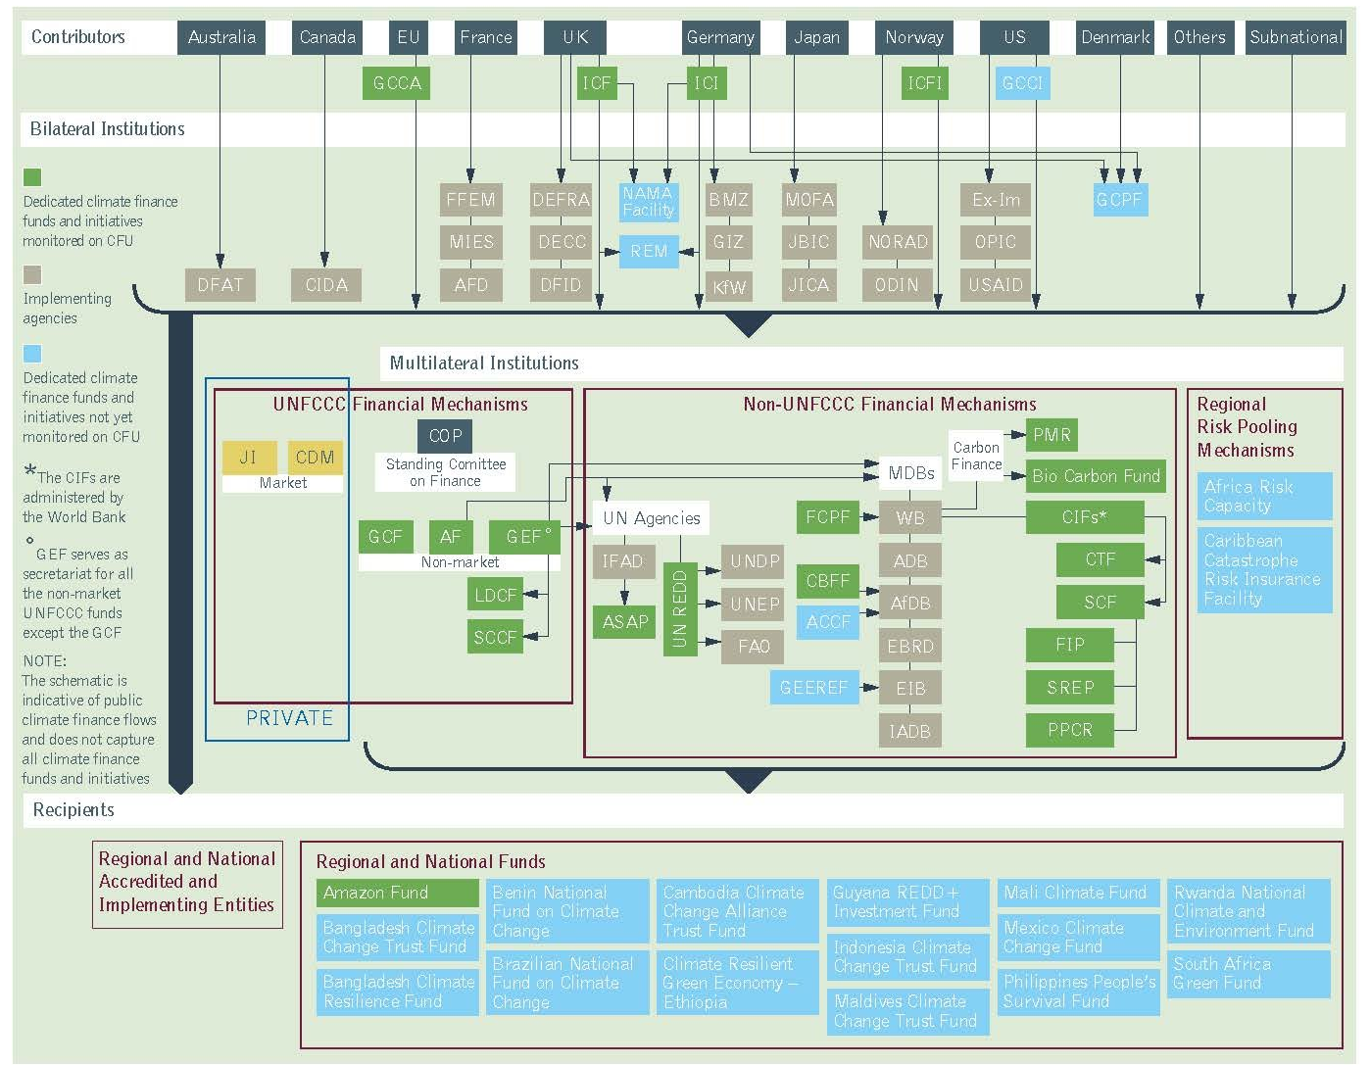
Institutional structure of climate finance
Donor developed countries – Bilateral institutions – Multilateral institutions (incl. MDBs) – Beneficiary developing countries
Mária Bábosik

Slide 6
Climate finance flows (USD bn/year, 2014)
Mária Bábosik

Slide 7
Multilateral Development Banks for climate finance
Mária Bábosik

Slide 8
Multilateral development banks (MDBs)
Bank
Subscribed capital
World Bank
USD 269 bn
Asian Development Bank
USD 143 bn
African Development Bank
USD 143 bn
Inter-American Development Bank
USD 143 bn
European Investment Bank
EUR 242 bn
European Bank for
Reconstruction and Development
EUR 30 bn
Mária Bábosik

Slide 9
Importance of MDBs
International financial institutions (global & regional)
Members of the post-WWII Bretton Woods system
Established by sovereign states
Important financial intermediators: provide long-term financing for fostering economic growth & development
For developing and transition countries
loans & guarantees, technical advice, equity
Create norms
Climate finance ranks high on their strategic agendas
Play an important role in delivering USD 100 bn/year by 2020 climate finance commitment of the developed countries
Mária Bábosik

Slide 10
Climate finance by MDBs (2016)
6 MDBs total climate finance: USD 27.4 bn (2015: USD 25 bn)
77% mitigation, 23% adaptation
Total climate action with co-financing: USD 65,3 bn
Cumulated climate finance investment 2011-2016: USD 158 bn
(2015: USD 130 bn)
Geographical distribution:
Largest share: South Asia & the Pacific (19%)
2nd largest: Non EU Europe & Central Asia (18%)
Middle East: & North Africa: (9%)
Sub-Saharan Africa (7%)
73% in investment loans
Narrow focus on renewable energy & energy efficiency
Source: Joint report on multilateral development banks’ climate finance 2016
Mária Bábosik

Slide 11
Example: WBG renewable energy projects - impact on 50 million people
World Bank Group:
… is actively helping countries and companies around the world to reduce emissions, prepare for the impacts of the climate change, scale up climate-smart investments, and meet the goals of the Paris Agreement.”
„2016 was another year of strong climate action…”
Renewable energy projects representing 10 gigawatts of generation capacity, and 10 new operations, that when in place will improve the climate resilience of over 50 million people”
John Roome
Senior Director for Climate Change
World Bank Group
Source: WBG Press release No 2018:017/GCC, http//: www.worldbank.org/en/news/pre (Assessed: 15.05.2018)
Mária Bábosik

Slide 12
2020 Climate finance targets of MDBs
MDB | 2020 Climate Finance Target
Asian Development Bank | USD 6 bn annually of own resources (2015: USD 3 bn)
African Development Bank | 40% of annual investments (ca. USD 5 bn) (2011-2014: 26%)
Inter-American Development Bank Group | 30% of annual operational approvals (ca. USD 4 bn) 2012-2014: 14%
European Bank for Reconstruction and Development | 40% of annual investments for green finance* (ca. EUR 3.6 bn) (2010-2014: 25%)
European Investment Bank | 35% of annual lending (ca. EUR 2 bn) (2015: 25%)
World Bank Group | 28% of annual commitments (ca. USD 16 bn) 2015: 21%
* Climate finance plus projects with a positive environmental impact
Source: Connecting multilateral climate finance to mitigation projects, Mitigation Momentum, 2017, p. 13.
Mária Bábosik

Slide 13
How to reach climate finance targets of MDBs
Enlarge the scope
Improve efficiency
Establish new MDBs
Increase sources for climate finance
Mobilize private capital (co-financing with private sector)
Provide risk sharing facilities by partial credit guarantees
Introduce financial innovations (green bonds, cat bonds, green credit lines, insurance products, …)
Include environmental & social assessment in all projects
Raise awareness, share knowledge, build up capacity, knowhow in risk assessment, join initiatives
Help to create bankable & environmentally sustainable projects
Improve project design & management, coordination
Use technical & financial experts
Tackle multiple barriers
Scale up to expand an initial intervention
Replicate to reproduce a specific intervention in a different location
Mix scaling up & reproduction

Slide 14
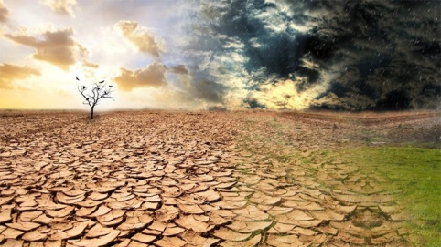
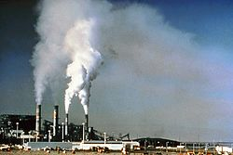
Conclusions
Climate change needs huge amount of additional financing.
MDBs play a crucial role in climate finance.
They are committed to it and make efforts.
Some 40% of climate finance is done by MDBs.
Climate finance amounts to 15-20% of their financing activity.
In order to meet targets there is a need to enlarge the scope and increase efficiency.
Attracting private capital, financial innovations, scaling up and replicating is essential to cope with the challenges.
Mária Bábosik

Slide 15
Thank you for your attention!
babosikm@mnb.hu
Mária Bábosik

